Slide 1
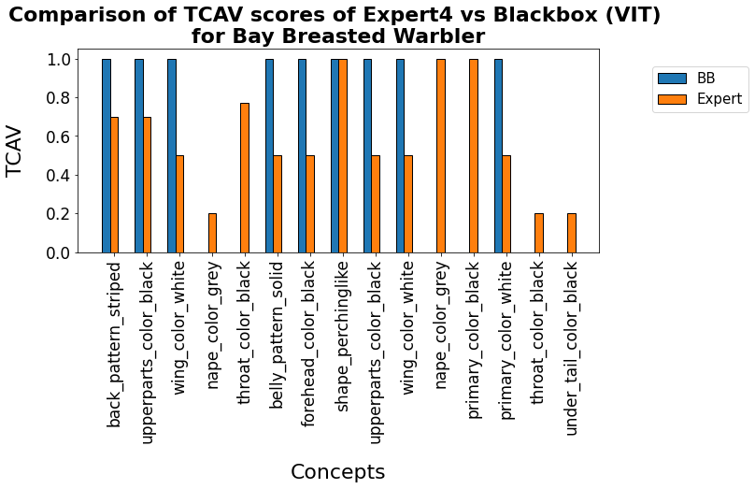
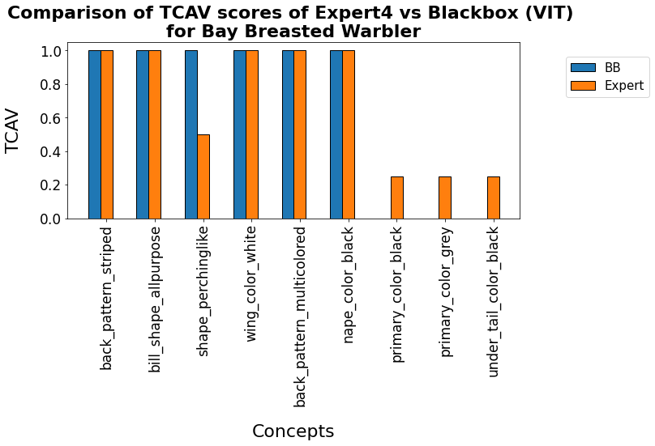
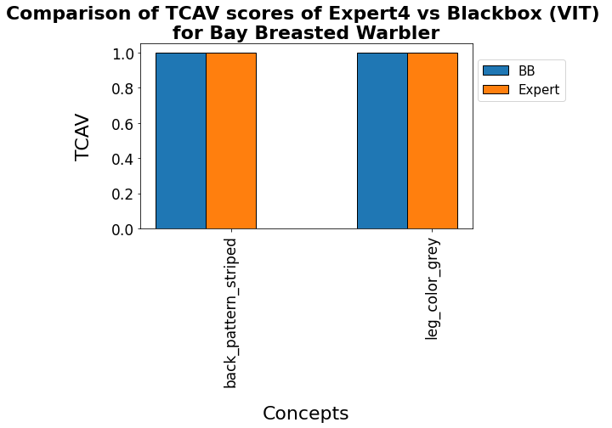

Slide 2
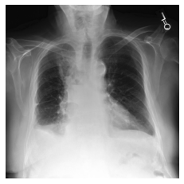
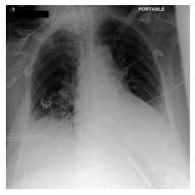
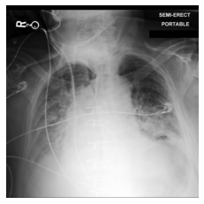
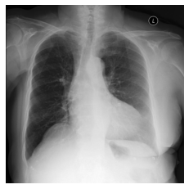
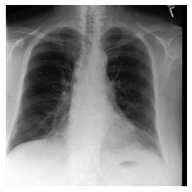
Effusion
Expert1
Expert1
Expert1
No Effusion
Expert1
Expert2
Expert3

Slide 3
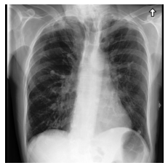
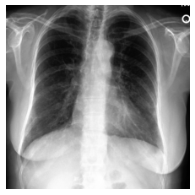
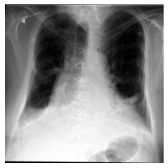
Cardiomegaly
Expert1
Expert1
Expert1

Slide 4
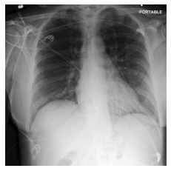
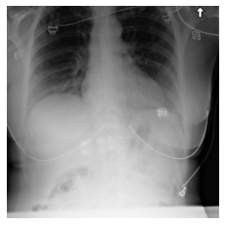
No Cardiomegaly
Expert1
Expert2
Expert3

Slide 6
(a)
(b)

Slide 7
(a)
(b)

Slide 8
(a)
(b)

Slide 9
(a)
(b)

Slide 10
(a)
(b)

Slide 11
(a)
(b)

Slide 12
(a)
(b)

Slide 13
(c)
(d)

Slide 14
(e)
(f)

Slide 15
(a)
(b)

Slide 16
(c)
(d)

Slide 17
(a)
(b)

